Slide 1
CDJ Scheduler
By: Chad Reynolds, Darcie Odom, Jeremy Scott

Slide 2
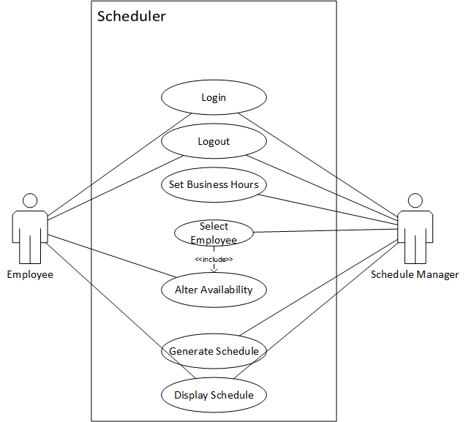
Use case
Scheduling system that delivers tools for weekly scheduling of employees

Slide 3
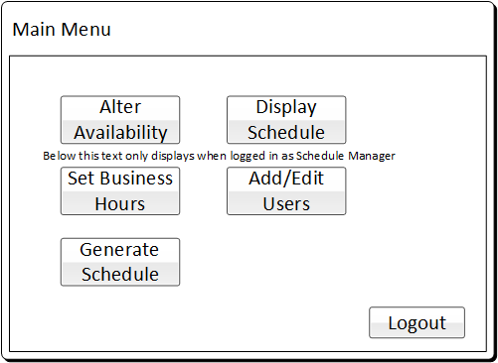
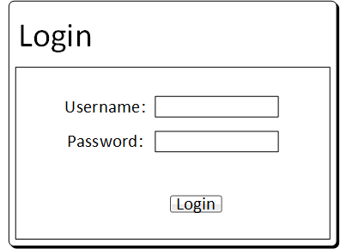
Login & main menu
Valid credentials brings user to the Main Menu
Main Menu provides list of major system functionalities that are available only after login
Logout can only be performed from Main Menu

Slide 4
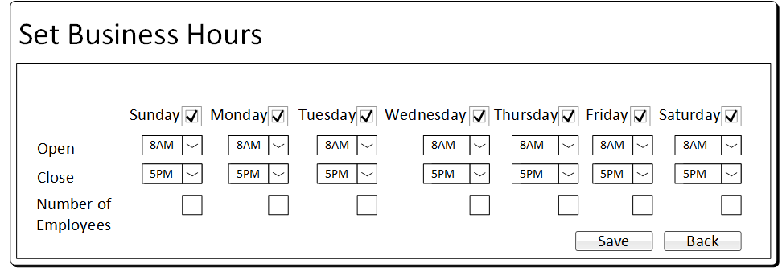
Set Business hours
Schedule Manager is able to set the parameters for the working hours of the business

Slide 5
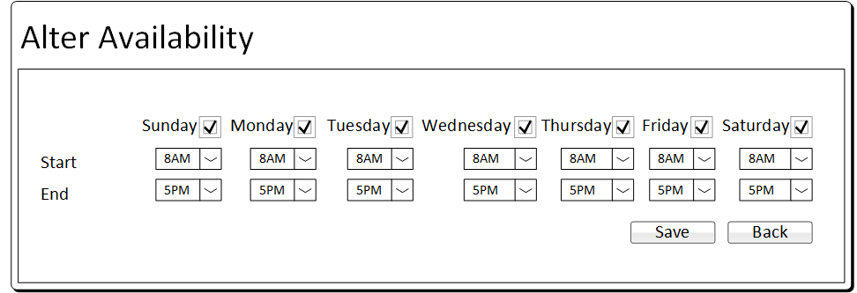
Alter availability
Employee selects days and timespans they are available to work

Slide 6
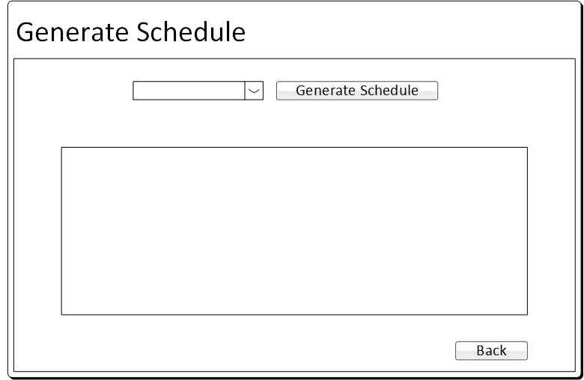
Generate schedule
Different options allow Schedule Manager to determine priorities for the schedule generation
Bottom box displays schedule or error message if schedule cannot be created

Slide 7
conclusion
Potential improvements
Questions or suggestions?

